Slide 1


Prevention of Respiratory Insufficiency after Surgical Management:
PRISM trial
Site Initiation Presentation
Hospital name
Date
Notes:
1
1
1
Hello and welcome to the PRISM Trial Site Initiation Presentation.

Slide 2

PRISM contacts
Chief Investigator: Rupert Pearse & Marco Ranieri
Research Fellow: Tom Abbott
Senior Research Manager: Priyanthi Dias
Research assistant: Mari-Liis Pakats
PRISM Website: www.prismtrial.org
Contact email: admin@prismtrial.org
Follow us on Twitter : @prismtrial
Notes:
Introduction of coordinators and site team
Please use the above email for any trial related correspondence.
Please refer to our website for any study documents, contacts, slideshow etc.
We are also twitter active, you are welcome to follow us if you wish.

Slide 3
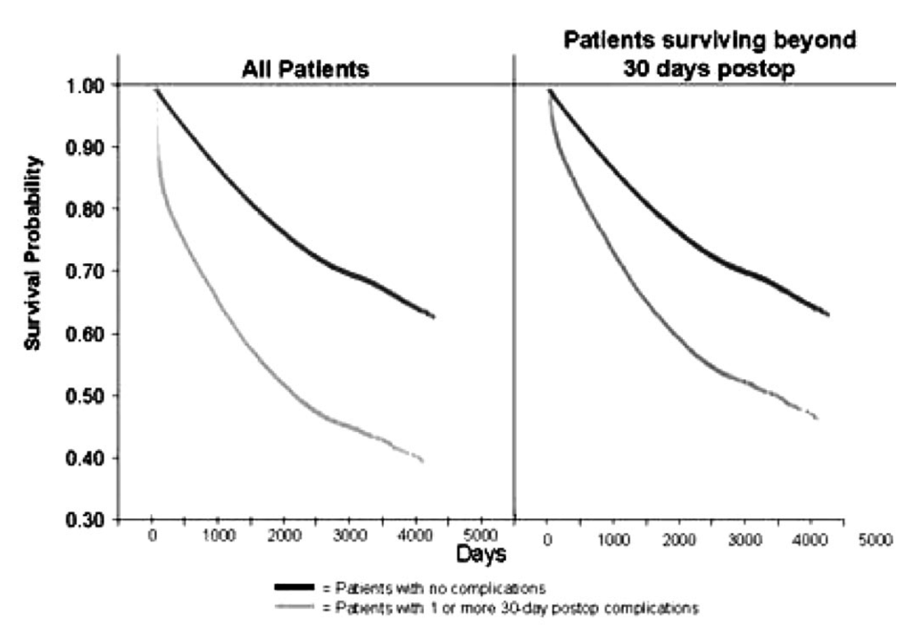
Postoperative complications decrease
long-term survival
Khuri et al. Annals of surgery 2005; 242: 326-41.
Notes:
The presence of any postoperative complication has a negative impact on survival following surgery.
So preventing postoperative complications is a very important public health intervention.
We know that survival after surgery for patients who have complications is reduced.
The above graphs are data from Khuri and colleagues which show from the survival curves – the bottom curves are with complications and the top without
This effect is seen for all patients and patients with pulmonary complications

Slide 4
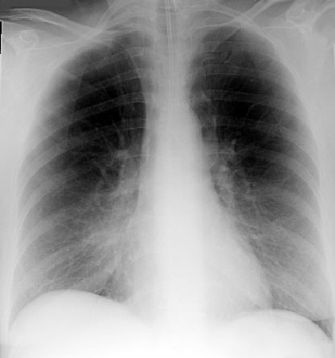
The problem
  Atelectasis
  Pulmonary collapse
  Pneumonia
  Respiratory failure
Notes:
Major abdominal surgery can have a significant negative impact on postoperative respiratory function.
This is due to the effects of:
Anaesthesia
Muscle relaxants
Surgical manipulation
Leading to: atelectasis and collapse, which promotes pneumonia and can lead to respiratory failure. Patients with postoperative respiratory failure are at high-risk of death.
We think that there is a clear reason why anaesthesia and surgery can affect the respiratory system postoperatively

Slide 5
CPAP may prevent respiratory failure after abdominal surgery
Ferreyra G et al Ann Surg 2008; 247: 617–626.
Notes:
CPAP is a promising candidate prophylactic treatment to prevent respiratory complications after surgery.
There is evidence of efficacy, but existing trials are small scale, single centre and homogeneous. As a result CPAP is not used very widely
PRISM is a large scale pragmatic effectiveness randomized controlled trial in heterogeneous population which will have generalizable results and potentially lead to a change in clinical practice. PRISM is the biggest perioperative medicine trial in the UK and one of the biggest in the world. We are very happy to have you on board!

Slide 6
Objective
  To determine whether early postoperative continuous positive airway pressure (CPAP) reduces the incidence of respiratory complications and improves one-year survival following major intra-peritoneal surgery.

Slide 7
Trial design
  International multi-centre randomised controlled trial
  Open study group allocation
  Sponsored by Queen Mary University of London (UK)
  Sample size = 4,800 patients
  Elective surgery only
  50 sites (25 UK and 25 Italy)
Notes:
PRISM is a large international multicentre randomised controlled trial with open study group allocation for hospitals undertaking elective intra-peritoneal surgery in participating countries.
Recruitment will mostly be split between the UK and Italy, but we also have sites in Sweden, Norway and Spain.
Up to now we have recruited … patients and have ca … sites open.
The study is sponsored by QMUL in the UK. An agreement is in place between QMUL and Universitas di Roma which delegates responsibility for coordination of the Italian half of the study.

Slide 8
Trial Design
Day of surgery
Consent
Elective Surgery
Randomisation
Intervention
Before surgery
Screening
Patient information sheet
In-hospital follow-up
1-year outcomes
30-day outcomes
Notes:
A rough timeline for the study:
Patients should be given plenty of time to read the PIS when consenting. We should try to avoid consenting on the day of surgery.
Please randomise once the surgery has completed and you are certain that the patient can receive the intervention if randomised to the treatment arm.
We recommend following the patient up while they are still in hospital to avoid any unnecessary delays caused by accessing notes (if they are on paper)
30 day follow up – phone call to the patient for any complications since discharge and an EQ5D.
1 year – EQ5D and mortality

Slide 9
Recruitment
  Aim to contact patients at least 24 hours prior to surgery
  Identify patients in the pre-admission or surgical outpatient clinic
  The first approach should be by a member of the clinical team
  Written informed consent must be obtained before surgery
  Keep a log of all the patients screening for participation.
Notes:
The first approach should be by a clinician e.g. pre-assessment clinic nurse or doctor, surgeon in the surgical outpatient clinic etc.
Provided that all reasonable efforts have been made to identify a potential participant 24 hours before surgery, they will still be eligible for recruitment within a shorter time frame if this has not proved possible.
However, recruitment of patients on the morning of surgery should be “the exception rather than the rule” (exact words used by the REC chairman).
Screening log – Please include patients you would have thought to approach for the trial. We would like you to recruit one patient per week if possible. However, we would like you to concentrate on compliance rather that recruiting lots of patients.

Slide 10
Informed consent
  PI or delegate
  Explain aims, methods and benefits/hazards
  Patient information sheet
  Informed consent form
  Consent must be given before the start of surgery
Notes:
Anyone taking consent needs to have appropriate trial specific training, including Good Clinical Practice for Research and be recorded on the site delegation log.
Patients who lack capacity to give or withhold informed consent will not be recruited.
Our ICF is based on a CTIMP template hence the three lines on the form. For PRISM the PI does not need to countersign, instead the third line could be used for an interpreter or translator if necessary.
Remember – copies of the ICF and PIS need to go in the patient notes AND copy of the ICF goes to the patient. The ORIGINAL consent form should be stored in the investigator site file.
Consent should be confirmed verbally on the day of surgery. If the consent was signed a long time ago, the ICF should be resigned. The database will not let you enter a consent date >60 days from day of surgery.

Slide 11
Inclusion criteria
  Age ≥50 years
  Elective major intra-peritoneal surgery
  Planned use of open technique
Notes:
Major surgery = planned to stay in hospital for at least one night.
Intra-peritoneal surgery includes any major surgery that breaches the peritoneum i.e. includes: oesophagectomy (some but not all), gastrectomy, some gynaecological procedures (TAH with major clearances).
The planned surgical technique should be open. As per our definition: open surgery is where the incision is greater than that required to remove the specimen (e.g. for laporoscopic surgery extending the incision larger than is required to remove the specimen bag or externally removing part of the bowel to do anastomosis.) If you are unsure, please check our definitions with the surgeon before randomising the patient.
Please do not recruit patients that are planned to have a laparoscopic procedure with a small chance it will be changed to open.
Randomise once the surgery has finished and you have confirmed that the patient meets the inclusion criteria.
If you’re having to think too much about whether they would be eligible, they are likely not the kind of cases we are looking for

Slide 12
Exclusion criteria
  Inability or refusal to provide informed consent
  Anticipated requirement for mechanical ventilation for at least four hours after surgery
  Pregnancy or obstetric surgery
  Previous enrolment in PRISM
  Current participation in a clinical trial of a treatment with a similar biological mechanism or related primary outcome measure
  Clinician refusal
  Contraindication to continuous positive airway pressure (CPAP)
Notes:
Anticipated requirement for invasive or non invsasive mechanical ventilation for at least four hours after surgery. This mainly applies for patients with pre-existing conditions for example: sleep apnoea, myasthenia. Please randomise once you have confirmed that this is not required.
Participation in a clinical trial of a treatment with a similar biological mechanism or related primary outcome measure: please contact us beforehand and send us the protocol of the study.
Clinician refusal – please record on your screening logs whether the clinician objection is due to the surgical procedure category. This is most likely to be upper gastro-intestinal surgery.
Contraindication to continuous positive airway pressure (CPAP): please confirm this with the clinician before randomising.

Slide 13
Randomisation
  After informed consent
  After the surgery has completed (up to 4h after the end of the surgical procedure)
  Via the PRISM online database
  Randomisation criteria:
    Planned surgical procedure category
    Planned use of epidural anaesthesia
Notes:
Please only randomise the patient once you have confirmed the patient can receive CPAP should it be necessary. Please confirm the following:
Pt is not intubated or will be extubated within the time period.
Meets all the inclusion criteria and none of the exclusion criteria.
Trained staff, necessary equipment and appropriate bed is available to deliver CPAP
Would like to avoid patients being randomised to the intervention arm and not receiving CPAP. We are keen to increase our overall compliance rate.
Unfortunately there is no back up system for database so please give us a ring if there are any problems. The allocation group will be displayed on the screen upon randomisation and you will also receive an email confirmation. Please do not rely on the email due to recent problems, please have a look at the allocation on the screen.
If you are having any problems with the database, please do NOT re-randomise a patient but give us a ring and we will try to help!
Randomisation criteria – If multiple procedure categories apply, please use the single most appropriate procedure category.
It is perfectly fine to consent a patient and not randomise. We would prefer you to not randomise a patient if you are anticipating any problems.

Slide 14
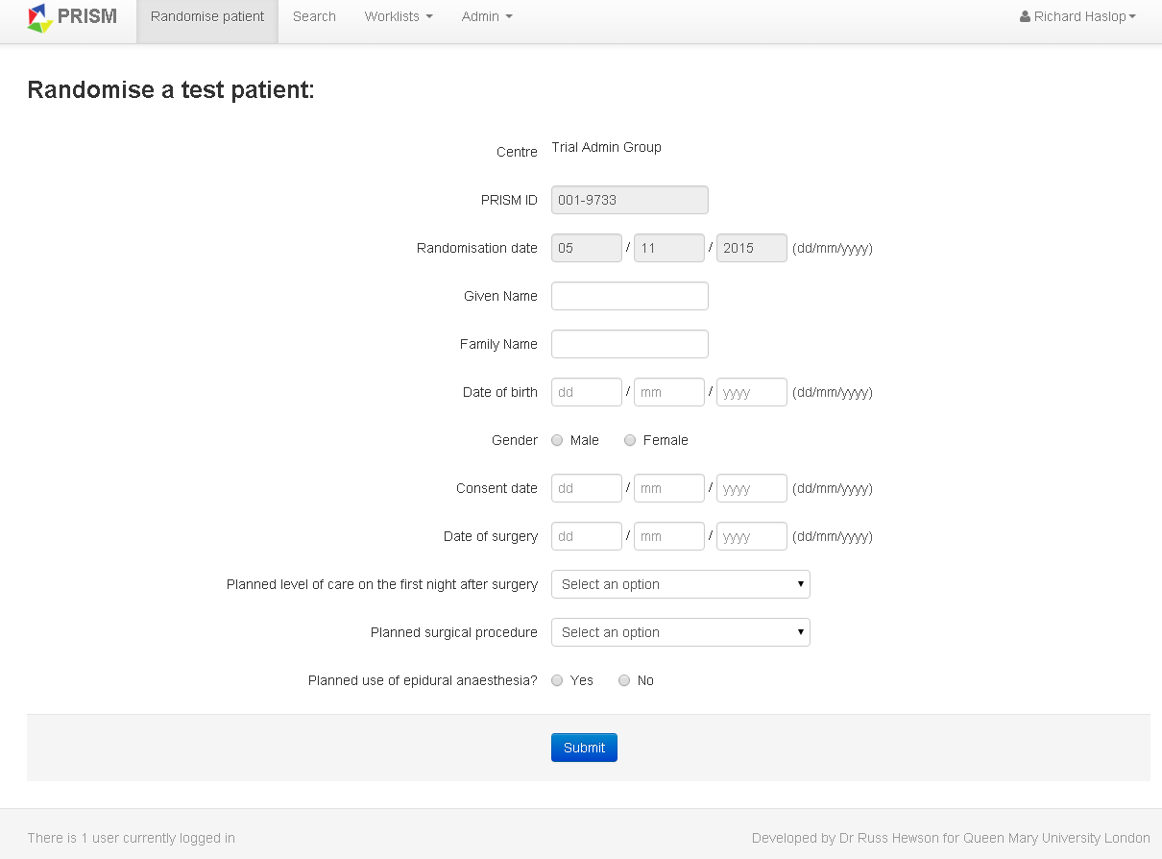
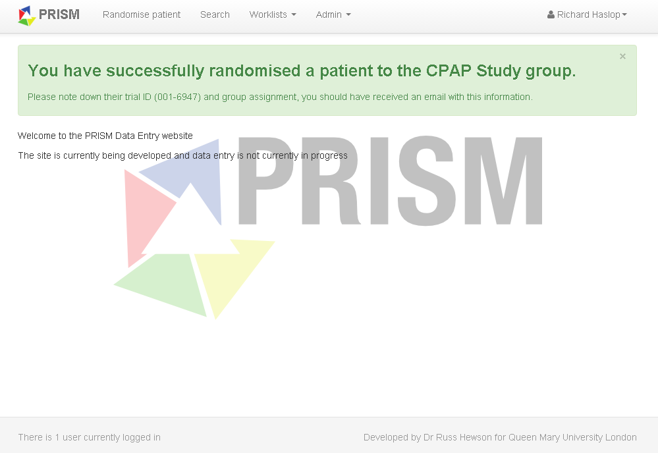
Randomisation
  Register at http://database.prismtrial.org
  Enter “username” and “password” provided at registration
  Click “randomise patient” and enter relevant information
Notes:
You can register for the database using the above link
For Principal Investigators, the registration will be confirmed by the central admin team. For all the rest of the local investigators, the registration will be verified by your PI.
When registered, enter your username and password for access to the database. You can then click ‘randomise patient’.
Please enter randomisation details as prompted by the form.
You will receive an auto-generated email following randomisation. Please keep this email as it contains the treatment allocation for the patient.

Slide 15
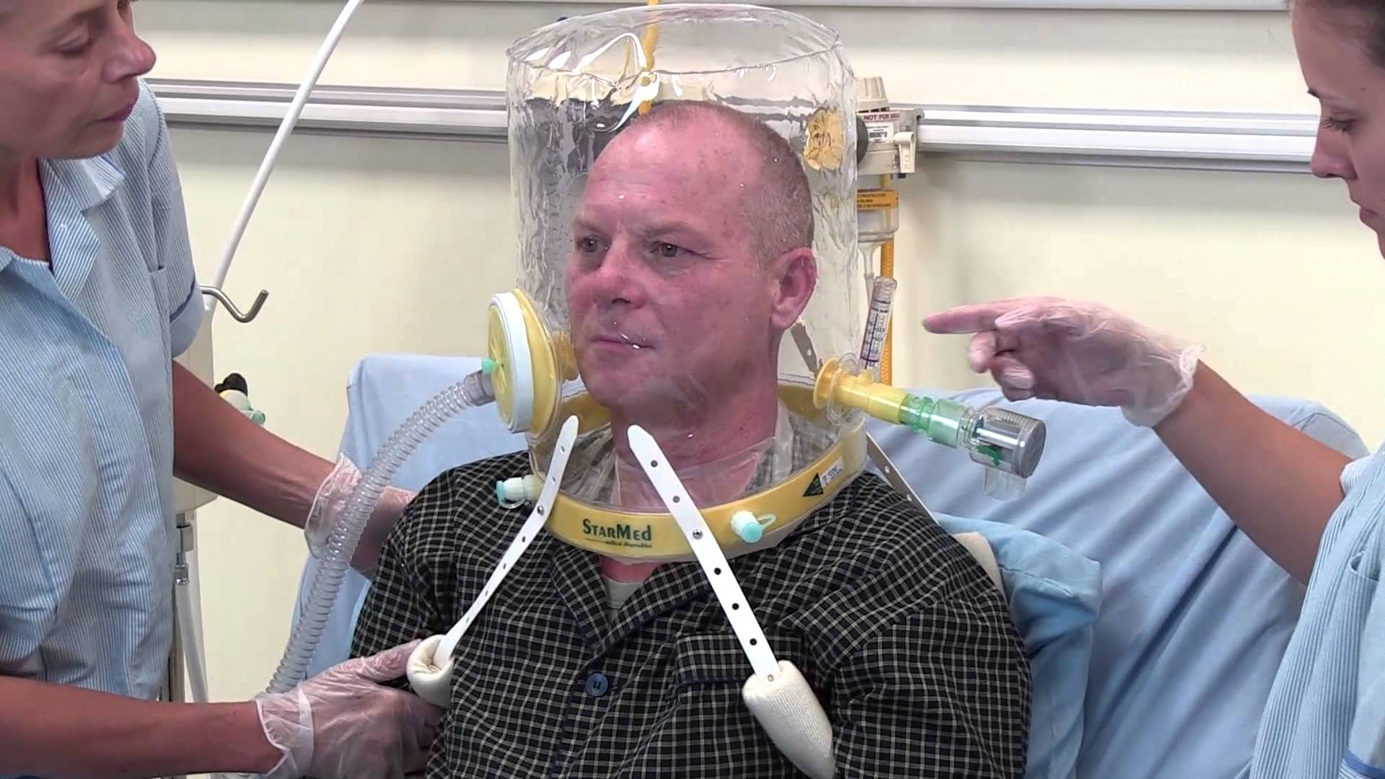
Intervention
  CPAP for at least four hours, ideally started within four hours of completion of surgery
Notes:
Intervention is defined as CPAP for 4 hours, ideally started within 4 hours of surgery. Where the start of CPAP has been delayed by exceptional circumstances (e.g. equipment failure, critical care admission, etc.), the intervention may be commenced up to twelve hours after the end of surgery.
Completion of surgery will usually be marked by wound closure and dressing.

Slide 16
Intervention group
  CPAP for at least four hours ideally started within four hours of the end of surgery
  Can be commenced up to 12h after the end of surgery
  Delivered by trained staff according to local policies
  Mask, nasal or helmet/hood delivery device
  Clinician can choose CPAP machine
  Minimum airway pressure 5cmH₂O
  Can be increased to maximum of 10cmH₂O
NB. HFNO is not considered CPAP
Notes:
Delivered by trained staff according to local standards in a suitable area.
On CRF: method of CPAP delivery = primary method i.e. predominant method.
Record total duration of CPAP within 12 hours of the end of surgery – this is an indication of the total dose of CPAP. Even if the start of CPAP is delayed OR there is a gap in the middle of CPAP delivery OR the total duration is shorter or longer than 4 hours, please record the total duration within 12 hours of surgery.
Consumables provided by Intersurgicals

Slide 17
Intervention algorithm
Completion of surgery
Patient transferred to appropriate clinical area for delivery of CPAP
CPAP started via mask, nasal or helmet device at airway pressure of 5 cmH₂O
Consider increasing airway pressure in obese patients
CPAP adjusted according to clinician judgement. Maximum airway pressure 10 cmH₂O
After 4 hours, CPAP continued at the discretion of clinician
Intervention period ends.
Follow-up procedures

Slide 18
Usual care group
  Managed by clinical staff according to hospital policy
  Facemask oxygen is usual good practice
  Usual care patients receiving CPAP within 12 hours recorded as protocol deviation
Notes:
Please record the use of high-flow nasal oxygen on the CRF.
Usual care patients receiving CPAP within 12h recorded as protocol deviation
Also, please let us know if high flow nasal oxygen begins to be used as standard practice in your hospital prophylactically as this could reduce the difference between the groups.

Slide 19
Primary outcome
  Pneumonia, endotracheal re-intubation or death within 30 days of randomisation
Notes:
Please make sure all your staff are clear about the definition on pneumonia as defined in the definitions section of the protocol.

Slide 20
Secondary outcomes
  Pneumonia within 30 days of randomisation
  Endotracheal re-intubation within 30 days of randomisation
  Death within 30 days of randomisation
  Postoperative infection within 30 days of randomisation
  Mechanical ventilation (invasive or non-invasive) within 30 days of randomisation
  All-cause mortality at one year after randomisation
  Quality adjusted life years (QALY) at one year after randomisation
Notes:
Tertiary outcomes to assess harm associated with CPAP.
Process measures.
Cost effectiveness.

Slide 21
Follow-up
  Review a participant’s medical record (paper or electronic) and contact them on the telephone to conduct brief interviews at 30 days and one year after randomisation
  Verified by the PI or designee
  After the completion of one-year follow up the PI or designee will lock each case so that no further data can be entered.
Notes:
Please refer to the definition appendix for definitions for complications.
We would like the PI to be involved in the follow up if there are any questions about complications. PI should verify the primary outcome cases.

Slide 22
Quality of life
  EQ-5D(3L) questionnaire
  Simple descriptive profile and index value for health status
  Ask the patient each question on the list and record the appropriate answer on the CRF
Notes:
Please by default ask EQ-5D questions to the patient rather than a family member if possible. As the questionnaire is embedded in the CRF, please do not give the CRF to the patient to fill in as it is not a patient facing document and has not been approved by the respective regulatory bodies.

Slide 23
Questions…..?

Slide 24
Data collection
  Case Report Form (CRF) completion:
  Timely and accurate
  Entered into eCRF
  Logins to access the eCRF will be issued by the trial team
Notes:
Please enter the data to the eCRF in a timely manner to ensure high quality data. This gives us an overview for how the intervention is being delivered at your site.
Visit the patient while they are still in hospital, then there is no need to request notes. Additionally you might be able to clarify the complications with the clinician if necessary.
Length of stay (critical care stay and hospital admission): <1 = 1 day, 25-48 hours = 2 days etc.
Duration of mechanical ventilation: cumulative duration within 30 days of rand.
Data should always be documented in the research notes so they don’t get lost. Monitor should be able to reproduce CRF from patient notes (both eCRF and paper). We would encourage you to take a copy of the relevant sections of the CRF for source data verification purposes. For example take a copy of the sections where the patient meets the criteria for pneumonia.
Active cancer: A current diagnosis of cancer excluding non-melanoma skin cancers. A previous diagnosis of cancer where the patient underwent curative treatment with remission is not considered active cancer. A surgical procedure where the indication is a presumed diagnosis of cancer, but which has not yet been confirmed with histology, should be considered active
PI’s account will be verified by the central coordinating team. After which the PI can verify the rest of the team’s accounts.

Slide 25
Minimising Bias
  Follow-up will be conducted by a member of research staff who is unaware of trial group allocation
  Complications will be verified by the local PI or designee who is unaware of trial group allocation
Notes:
It would be sensible to keep a log of the investigator that randomises +/- helps with the trial intervention and keeps an eye on the patient for the first 24h for AEs, so that the follow up can be done by a team member who is unaware of trial group allocation.
Person doing the primary outcome assessment needs to be unaware of the allocation.

Slide 26
Self assessment of blinding
  To quantify the degree of blinding, research staff will make a self-assessment of blinding when collecting follow-up data
  Grade as one of the following options:
    Suitably blinded
    May have known study group allocation
    Definitely knew study group allocation
Notes:
This will be reported in the main trial report as per OPTIMISE.

Slide 27
Protocol deviations
  Failure to administer CPAP to patients in the intervention group.
  Starting CPAP at a dose other than 5cmH2O
  Administration of CPAP to a patient in usual care group.
  Administration of CPAP for less than 4 hours.
  Administration of CPAP with significant interruption for a patient in the intervention group.
Notes:
Failure to administer CPAP to patients in the intervention group. This includes patients that unexpectedly remain intubated after surgery, or where CPAP is started more than twelve hours after the end of surgery. We would like to minimise the occasions where the patient in the intervention group does not receive any CPAP. This could be prevented by holding off randomisation as long as possible.
Ideally, the patients should receive the full 4h over the course of 12h. If the patient asks for the CPAP mask to be removed, we would encourage you to offer it again after a short break. On the CRF please record the total duration of CPAP within 12h.
Brief interruptions to CPAP to adjust mask, for oral care or routine nursing care are considered part of the intervention. However, if the interruption is prolonged this should be considered a protocol deviation.
Record in the CRF supplementary form – protocol deviations. If the deviation does not fit into any of these categories, please record as “Other”.

Slide 28
Adverse event reporting
  Only AEs clearly related to the use of CPAP will be reported
  PI responsible for confirming relatedness to CPAP
  Pre-defined AEs are listed in the AE SOP and protocol
  If AE does not fit into pre-defined categories record as ‘other’
  Clinician to decide if it is safe to continue using CPAP
  Please refer to the AE SOP
Notes:
CPAP is a very safe treatment – unexpected side effects unlikely to occur.
Only adverse events clearly related to the use of CPAP should be recorded using the PRISM adverse event reporting form (an appendix to the CRF). Therefore the patients in the control group cannot have an AE.
Please keep the PI involved when reporting AEs, the PI should confirm the relatedness to CPAP (this cannot be delegated to anyone else)
We have an AE SOP with a predefined list of events. If they are not on the list, please record under “other”.
It is up to the clinician to decide whether it is safe for CPAP to continue.
Please only record clinically significant events i.e events you would record in the patient’s notes.
For both: AEs and protocol deviations, please fill in a supplementary form at the end of the CRF and on the database. Please note the forms cannot be edited on the database for audit trail purposes. If you have any questions on what to include, please give get in touch.

Slide 29
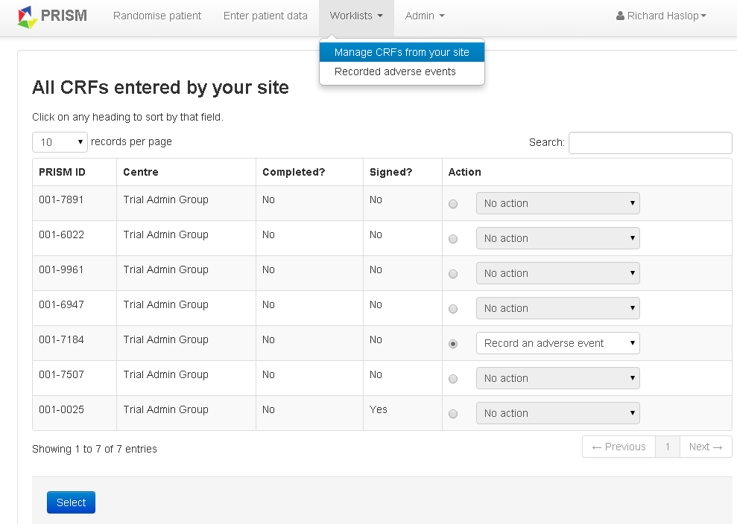
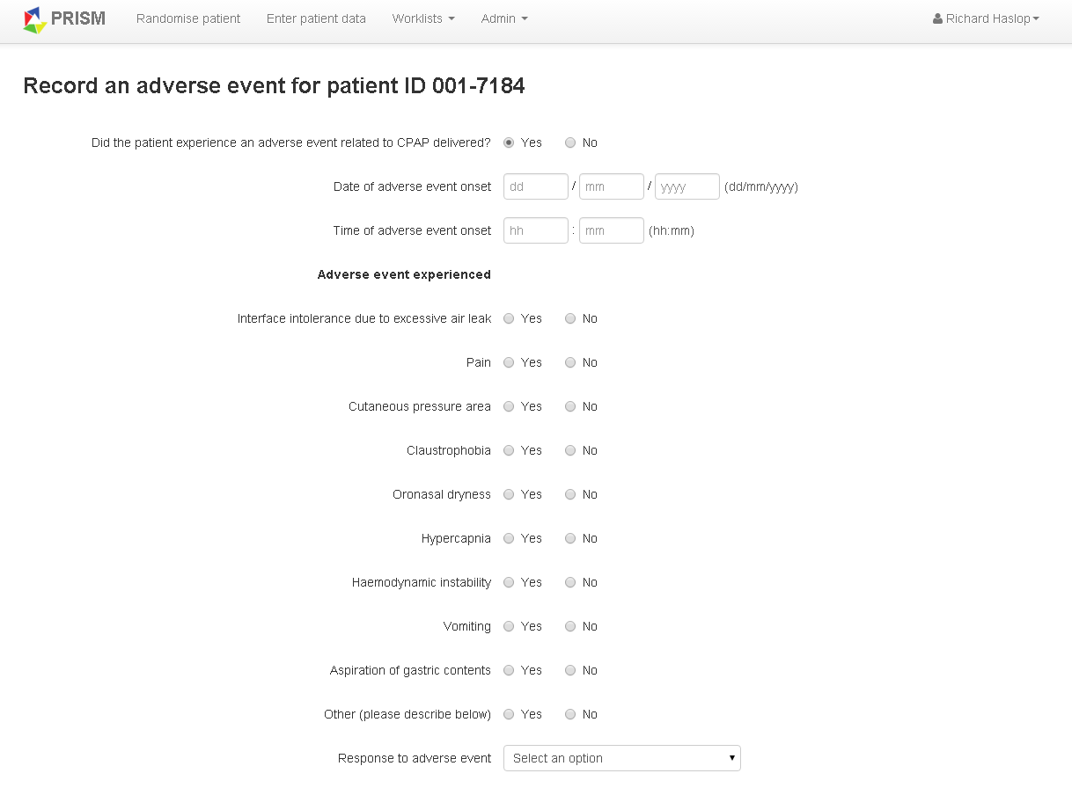
Adverse event reporting
Notes:
To enter an adverse event for a patient, click on Worklists, then ‘manage CRFs from your site’
Select the patient number by clicking ‘action’ and using the dropdown menu to record adverse event and select
The AE form will be brought up. Complete with accurate information making sure to enter a description (not viewable on this slide) then submit
You will be able to see AEs from your site by clicking worklists and ‘recorded adverse events’
Please do not include any patient identifiable data in the forms!

Slide 30
SAE reporting
  Report potential SAEs to the trial coordinating centre within 24 hours
  Must be assessed by PI (or suitably qualified nominee) as probably or definitely caused by CPAP and meet at least one of the following criteria:
    Results in death
    Is life threatening
    Clearly prolongs hospital stay
    Causes significant disability or incapacity
  CI will assess and discuss with PI as required
Notes:
For an adverse event to be classified as serious, it must meet one of the above criteria.
If one of the above criteria is met, and the AE has been assessed by the PI as probably or definitely caused by CPAP, please record as appropriate on the adverse event form and notify the PRISM trial coordinating centre by email within 24 hours of becoming aware of the event. Please use the patient’s trial number and do not include patient identifiable information.
Please also complete the online eCRF and submit for review. The CI will assess and discuss with the PI as required.
Complete a separate form for each adverse event.

Slide 31
SAE reporting
Untoward medical occurrence in a patient in the intervention group
Is the untoward occurrence clearly related to the use of CPAP?
No
Not an adverse event. Does not require reporting as part of PRISM trial.
Yes
Has it resulted in death, significant disability or incapacity, prolonged hospital stay or is it life threatening?
No
Adverse event. Please report to the PRISM trial co-ordinating centre via the online case report form.
Yes
Serious adverse event. Please notify the PRISM trial co-ordinating centre by emailing admin@prismtrial.org and report specific details via the online case report form within 24 hours.
Notes:
Diagram of previous points.

Slide 32
Withdrawal
  All study participants are free to withdraw from the study at any time.
  All randomised patients will be included in the final analysis on an intention to treat basis, unless they specifically ask for their data not to be included.
  Record a reason using discontinuation form
Notes:
Withdrawal from the study will be defined by no data collection taking place past the point of withdrawal.
Participants must be asked whether we can still use data up to that date, or whether they would like their data removed from the database.
Patients should be encouraged to allow their data to continue to be collected following withdrawal – although obviously they are, of course, allowed to refuse this.
NB! Refusal of CPAP does not mean the patient is withdrawing from the study. If the patient refuses CPAP, please fill in a protocol deviation form.

Slide 33
Patient identifiable information
  Will be collected and entered on to the secure data entry web portal
  Please do not send any patient identifiable information by email to the trial office e.g. name, address, date of birth, hospital number, national insurance number etc. Use only the PRISM trial ID to identify a participant.
Notes:
We will be keeping patient identifiable information on the study database, which is encrypted in line with NHS requirements.
Please don’t send patient identifiable information by email as we do not have a secure email account. Always identify trial participants by trial number.

Slide 34
Monitoring
  Each site will receive 3 monitoring visits:
    Site initiation visit
    After 10 patients recruited or at 1 year, whichever is sooner
    Closeout visit
  100% Source Data Verification (SDV) up to 30 day follow-up for up to 10 patients at each visit. At closeout, patients monitored at first visit will have 1 year data verified
  Possible ad-hoc visits
  Site self assessment for random selection of 20% of patients
Notes:
SDV = source data verification.
Before the visit we will let you know which patients will be reviewed, to allow you to request patient notes etc.
Self assessment only includes data entry from the CRF to eCRF in case there is any systematic errors in entering data.
We recommend to enter data after the 30-day follow up has been completed. If the follow ups have been outstanding for a while, we might send you reports to remind you about data entry.
You can keep an eye on your outstanding data on the database under “Worklists” and “Incomplete CRFs at your site”.

Slide 35
Study Procedures
  Screening & enrolment log to be completed
  Investigator Site File (ISF)
  Delegation log signed
  Standard Operating Procedures (SOPs)
  Copies of all investigators CVs & GCP/RGF certificates must be filed in the ISF
Notes:
Screening log must be completed as part of the screening process for PRISM. We will send you quarterly templates to complete with summary data. You are welcome to either keep a paper or an electronic log. The templates can be found on our website.
Please complete the screening log each time pre-assessment clinic/ theatre lists are checked. Screening log should include the patients who are enrolled in the trial.
Enrolment log to be completed for each patient enrolled on the trial.
You should have received or about to shortly receive your Investigator site file, this contains all trial related documentation. Any new documents/correspondence will be sent to you by the trial management team and should be filed in the applicable section. If you are missing anything from your file please let the PRISM Trial manager know so this can be rectified.
Inside the Investigator site file is a delegation log which must be signed by the PRISM investigators including research team members who are working on the trial. Once this is completed a copy should be sent to the PRISM trial manager for their records. If any members of your team should leave or any new staff join your team the delegation log should be updated accordingly and a new photocopy sent.
There are a small number of standard operating procedures (SOPs) that must be read by each of these investigators too, they must sign off the PRISM SOP training log to confirm these have been read and understood.
Copies of all GCPs and CVs should also be filed in the investigator site file (ISF).

Slide 36
Trial Initiation
  When R&D approval is in place and all documentation has been sent to us, the trial can begin. Please send the following prior to activation:
  Localised patient documentation (PIS, ICF, GP letter)
  Signed protocol agreement
  PI CV&GCP
  R&D approval letter
  Completed delegation log
  Signed SIV checklist (at this meeting or after)
  The PI must register on the trial database and enter general site information.
Notes:
Please note that additional documents might be required for international sites.

Slide 37
Key points
  Each site must have regulatory approval
  Randomise after the surgery has finished
  Informed consent must be obtained
  Timely entry of CRF data into the eCRF

Slide 38
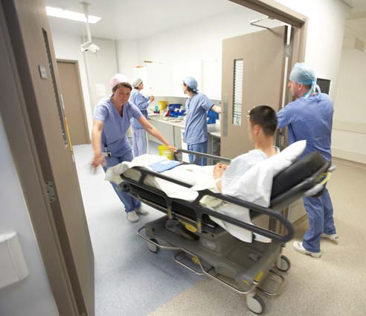
Last chance for questions...

